Slide 1
Data Science Development Tools
Part 1: Python, NumPy

Slide 2
Announcements
Updated Discord Link
Update TA Contact Info
Updated TA Hours
Chap 2 Reading - Part 1 - Due Jan 17

Slide 3
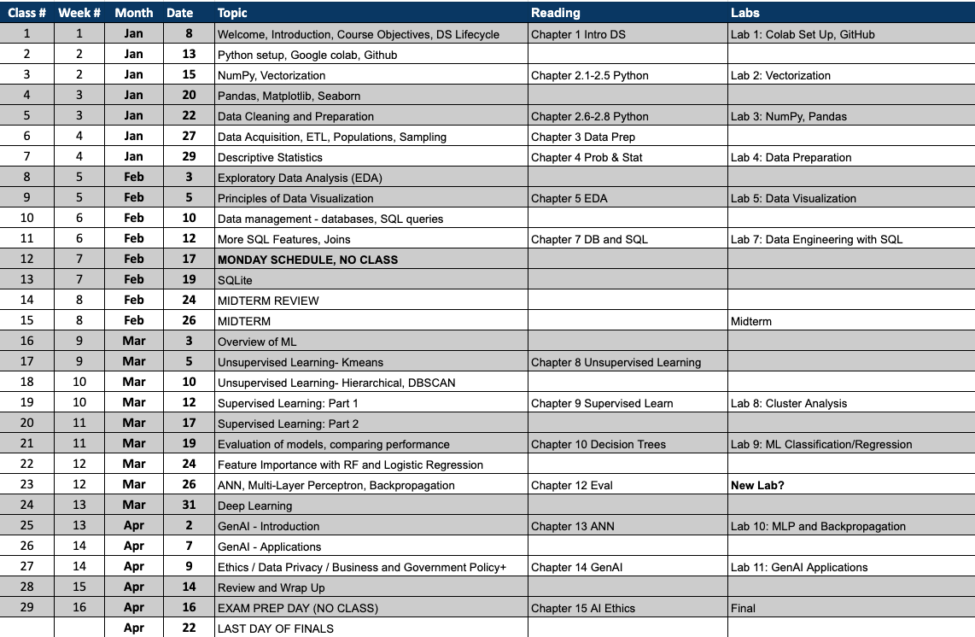


Slide 4
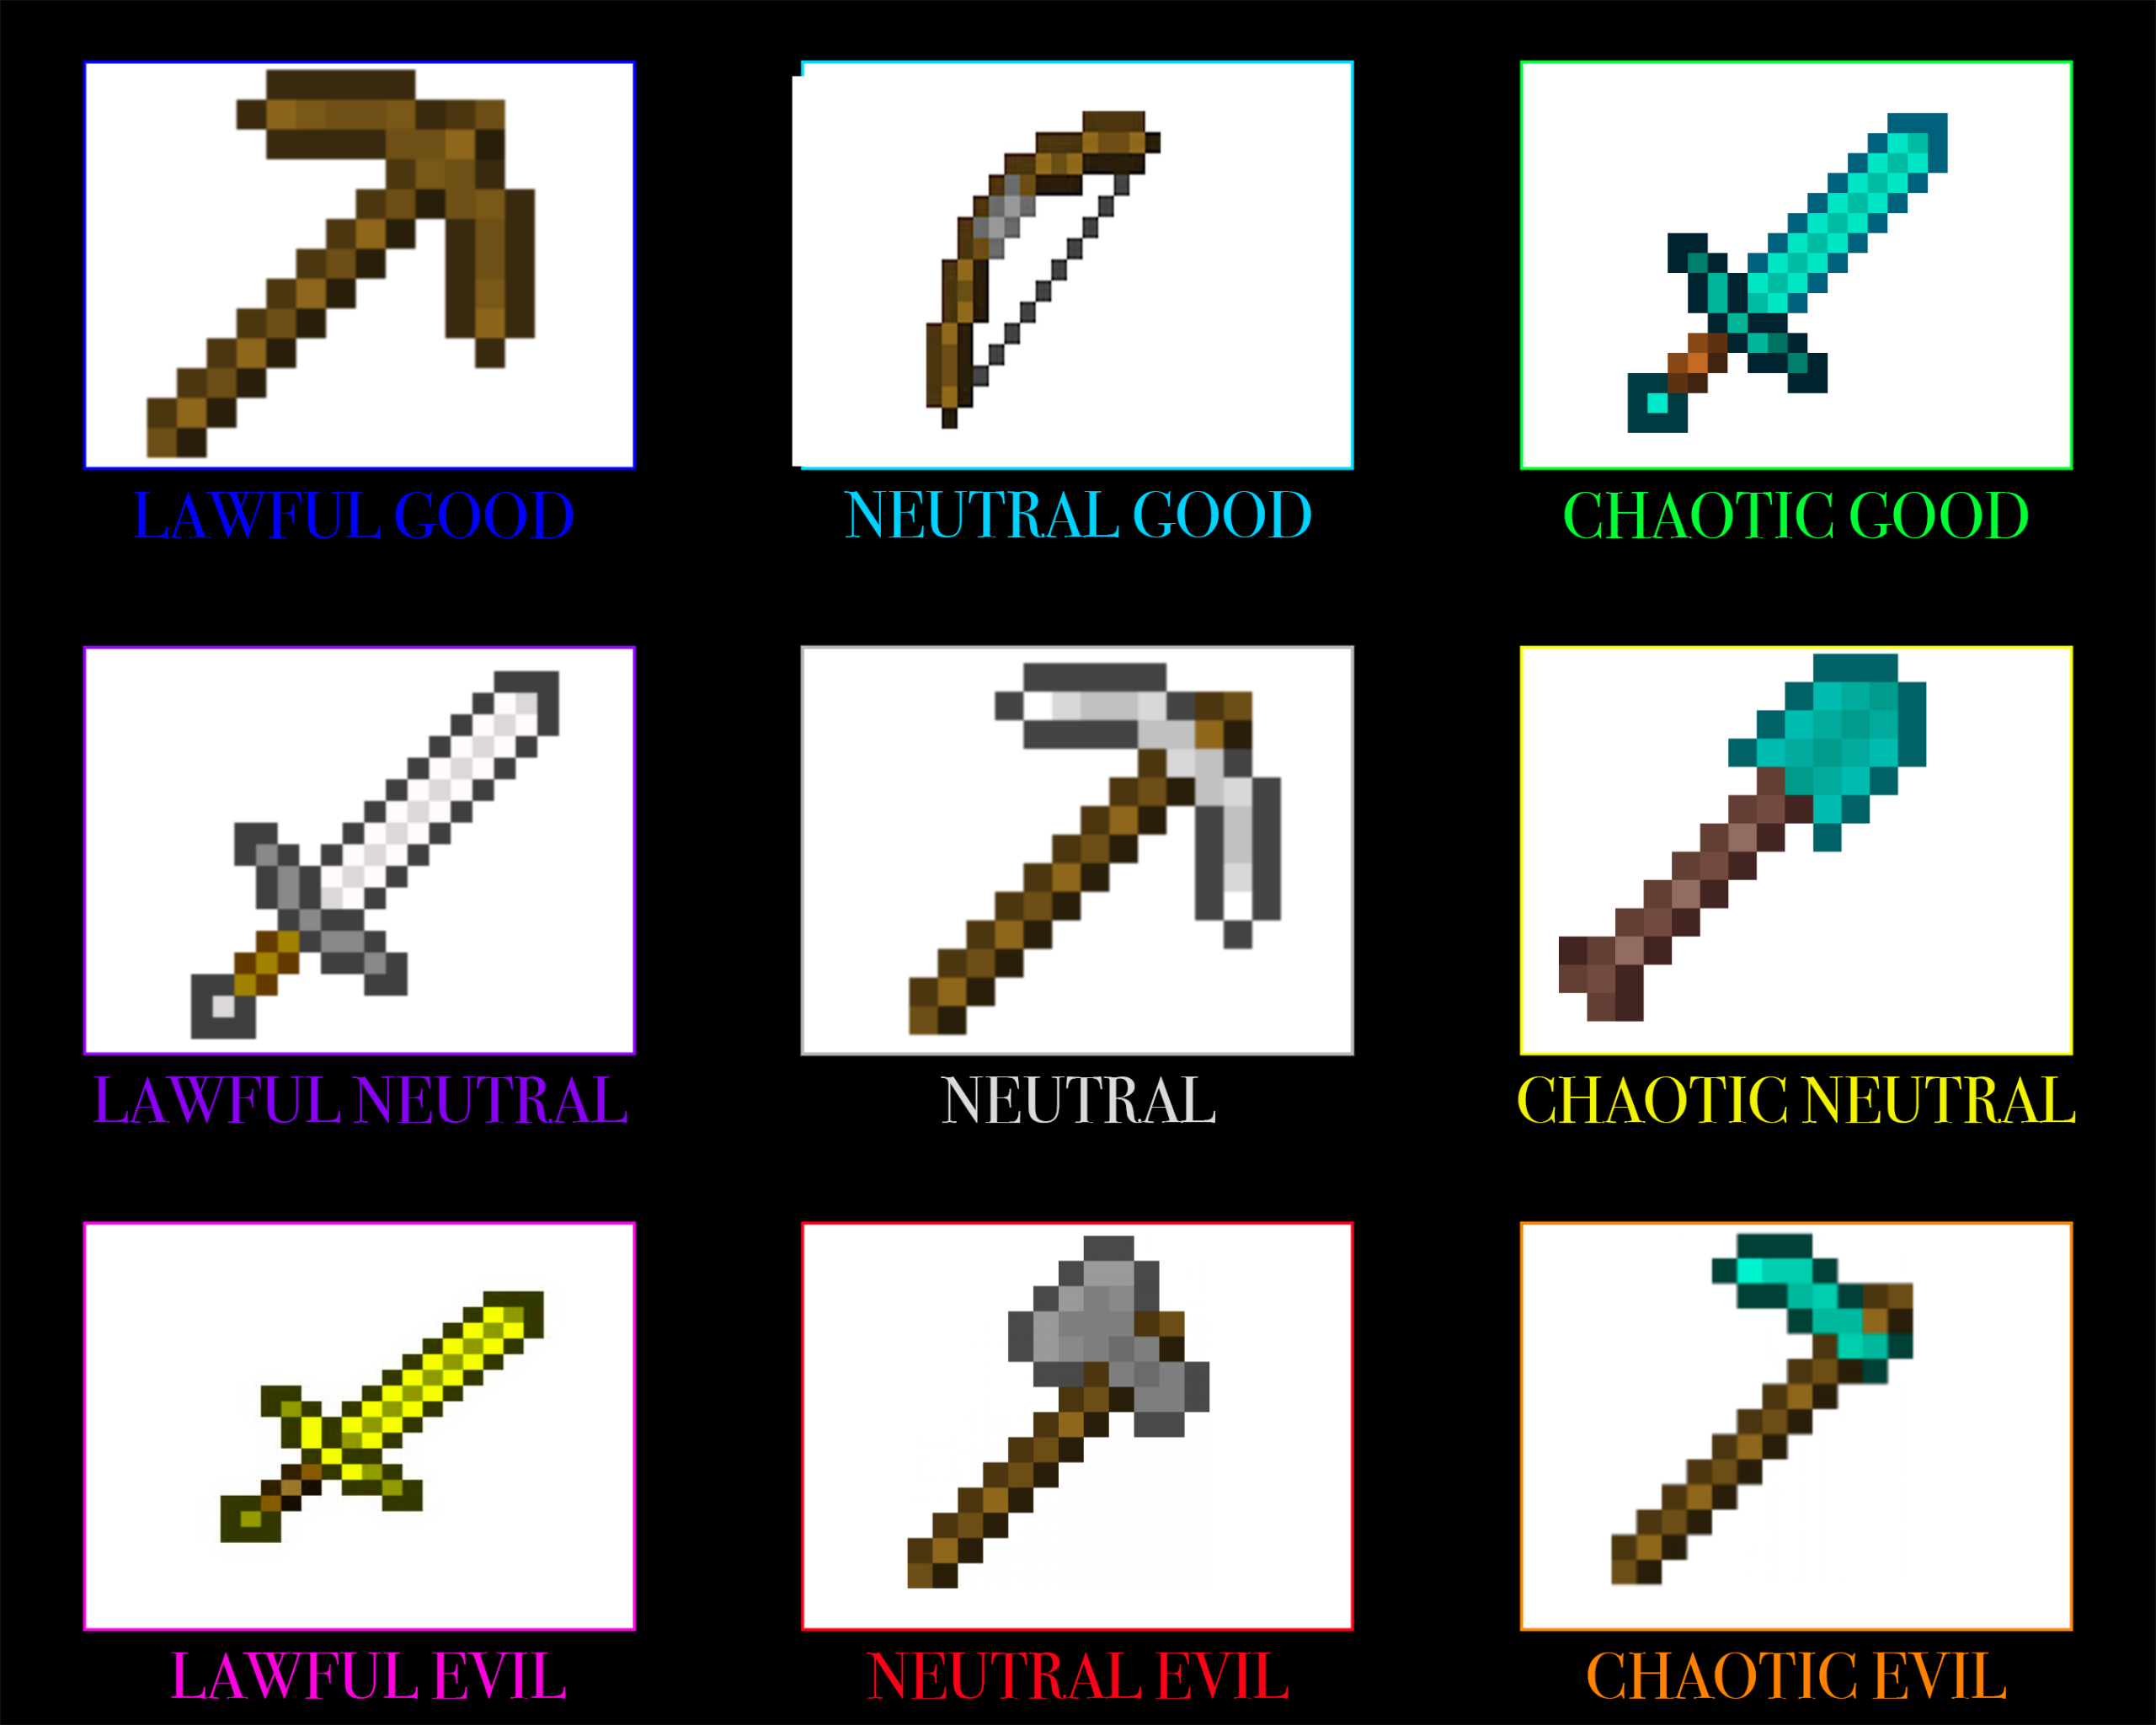
Tools for Data Mining
Start with Pickaxe and Shovel
Move to jack hammer and other automated tools
Languages - Python, SQL, R
Editors — Jupyter, Colab, VSCode, PyChar etc.
Libraries - NumPy, Pandas, Matplotlib, Seaborn, Scikit-Learn
Business Intelligence Platforms - Tableau, PowerBI
AWS QuickSight/SageMaker, Dataiku, DataRobot, DataBricks

Slide 5
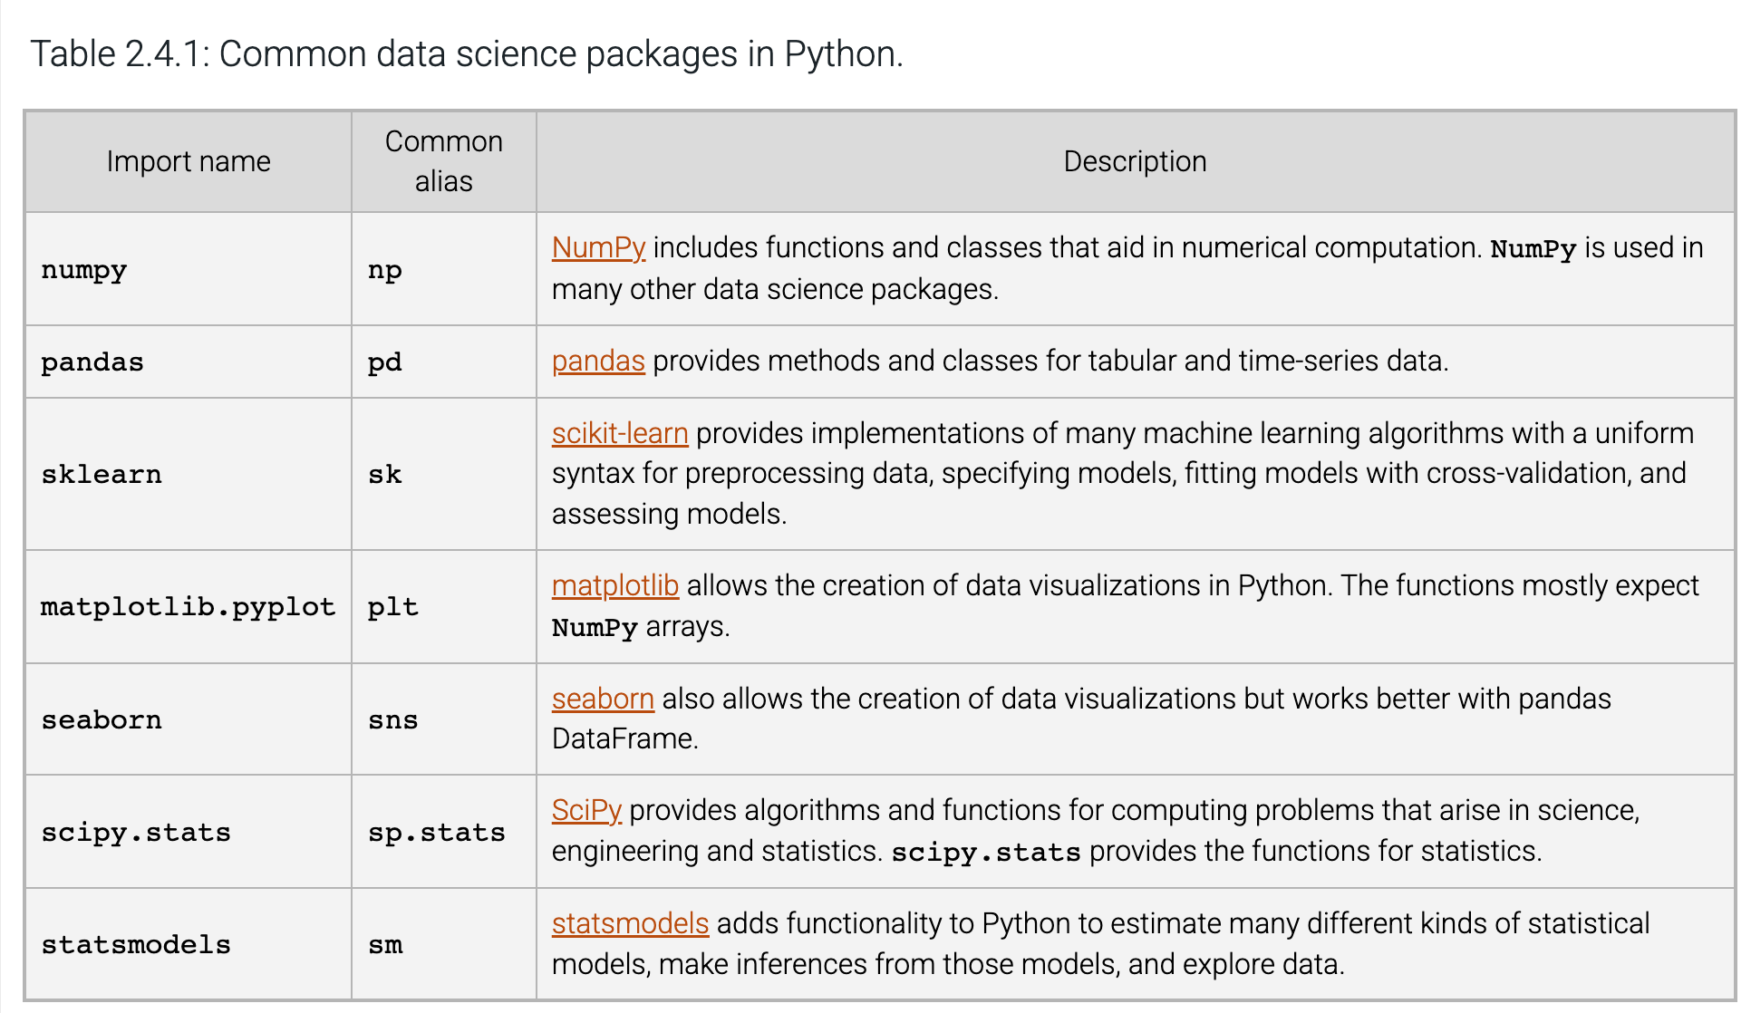
Common Data Science Packages for Python
CS 180

Slide 6
NumPy
Spelled: NumPy, Pronounced “num-pie”
What is NumPy? NumPy (Numerical Python) is the fundamental package for scientific computing with Python. It provides a high-performance multidimensional array object and tools for working with these arrays.
Why NumPy?
  Speed: NumPy arrays are more efficient and faster than Python lists for numerical operations, as they are implemented in C.
  Functionality: It provides a rich set of functions for linear algebra, Fourier transforms, and random number generation.
  Foundation: Many other data science libraries like Pandas, SciPy, and Scikit-learn are built on top of NumPy.
Originally Developed by Travis Oliphan - Assistant Professor 2001-2007
Notes:
Resources: https://www.youtube.com/watch?v=9JUAPgtkKpI, https://www.youtube.com/watch?v=lLRBYKwP8GQ

Slide 7
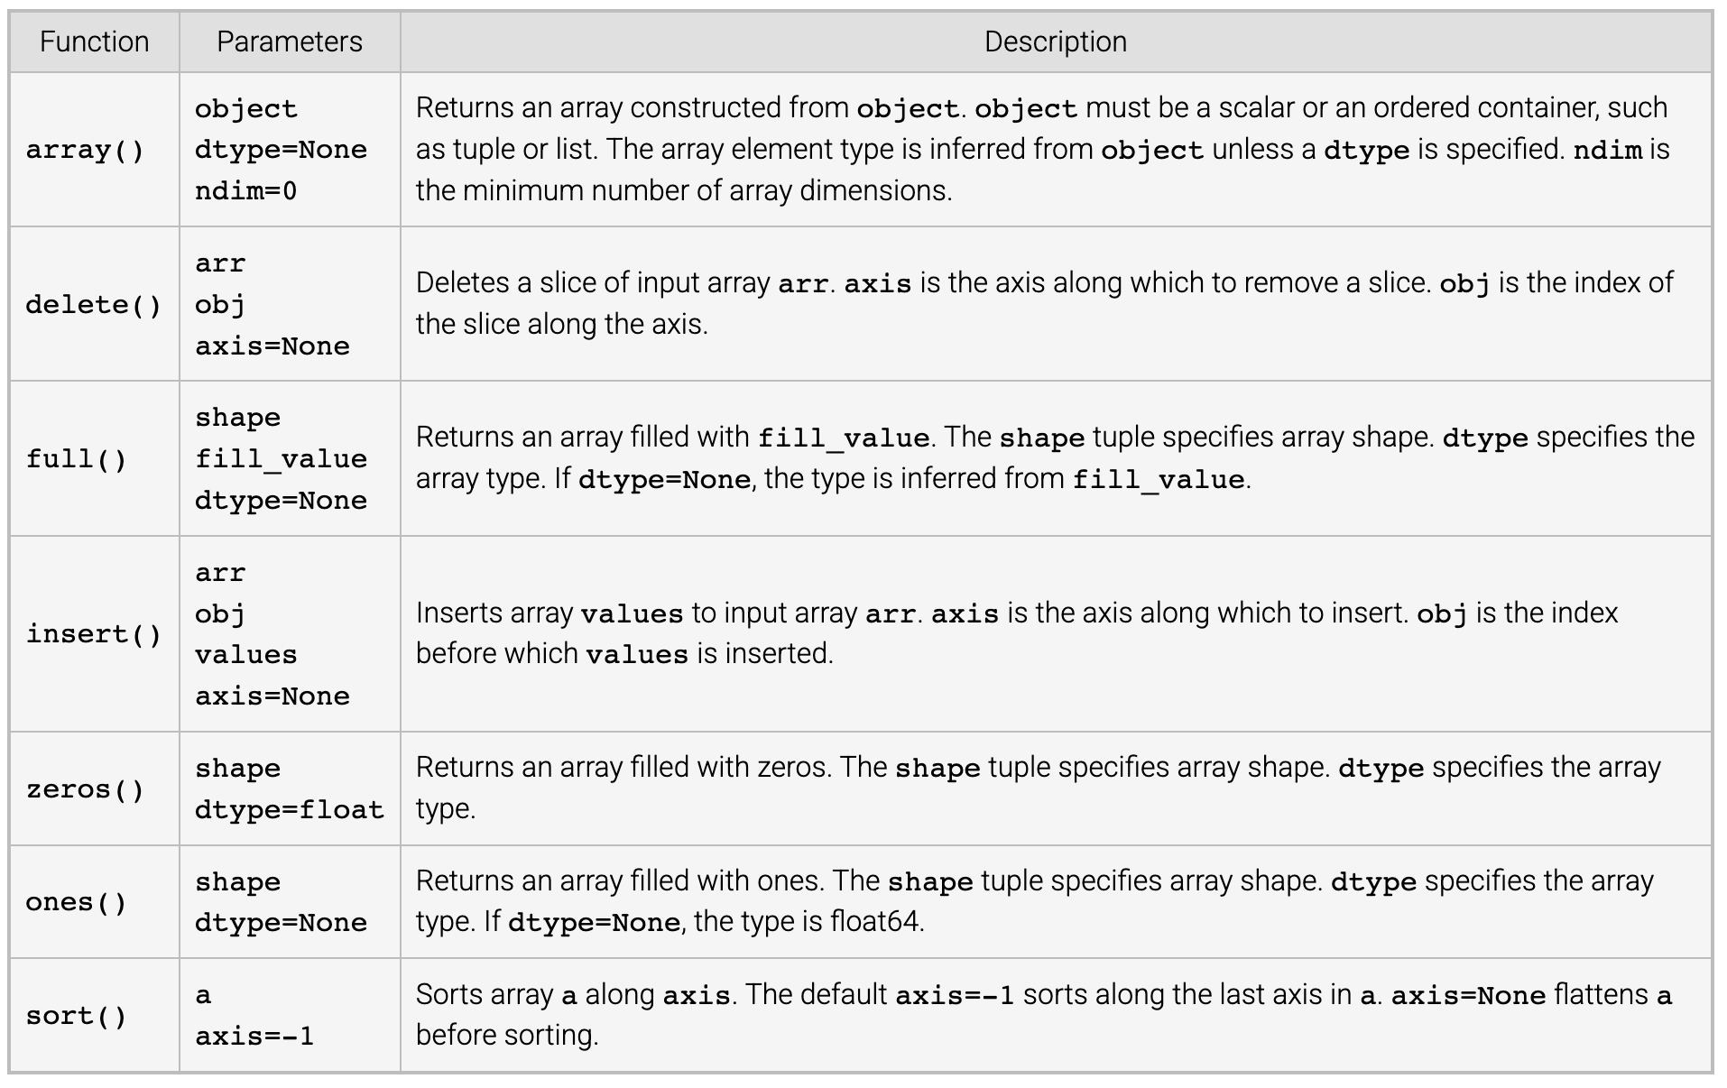
NumPy Array Functions

Slide 8
Upcoming Assignments
Reading: 2.1 – 2.5
DS Lab 2: Vectorization due Jan 17th 11:59 pm

